Slide 1
Introduction
Basic terminology
Types of network
architecture

Slide 2
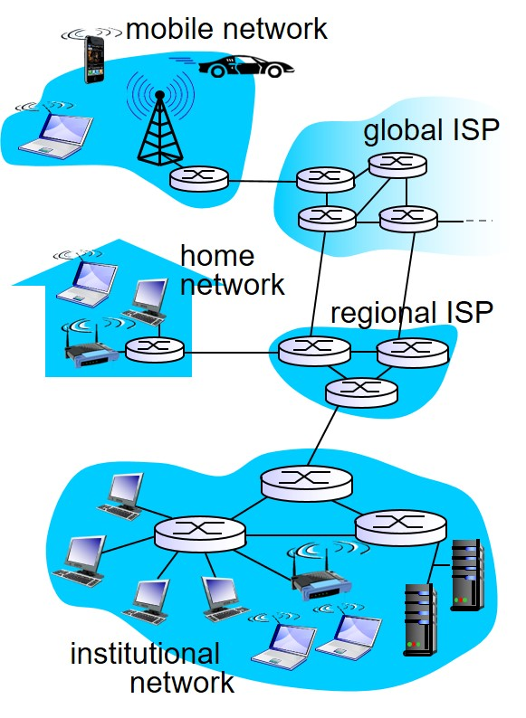
What is A Network?
A network is an interconnection of devices.
The computers/laptops connected to the network are known as end systems or hosts.
The digital data is fragmented into packets.

Slide 3
Classification of Networks
Transmission technology:
Unicasting : transmission with exactly one sender and exactly one receiver
Broadcasting : Packets are intended to all hosts
Multicasting : Packets are intended for a subset of hosts in the network
Scale:
Personal area networks
Local area networks
Metropolitan area networks
Wide area networks
Network of networks : example Internet

Slide 4
Components of a network
Communication link : A communication link is a physical medium that enable the end systems to exchange data.
Switch : A switch contains incoming links and outgoing links. Switch forwards a packet arriving on an incoming link to one of the outgoing links.
Routers (“Rooter” not “Rowter” - derived from rout)
Link-layer switches

Slide 5
Communication link
The communication link often referred to as communication media is of two types
Guided
Unguided
Examples of guided media :
Coaxial cable
Twisted pair
Optical fiber
If the communication link is an unguided media, the signals are transmitted and received wirelessly.

Slide 6
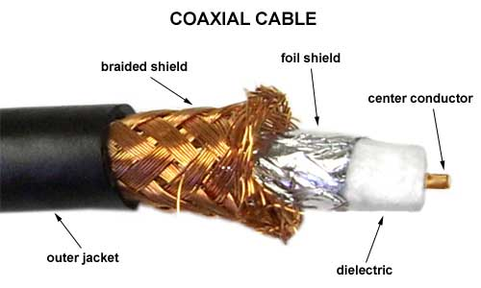
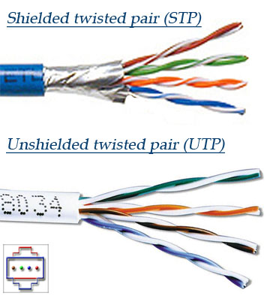
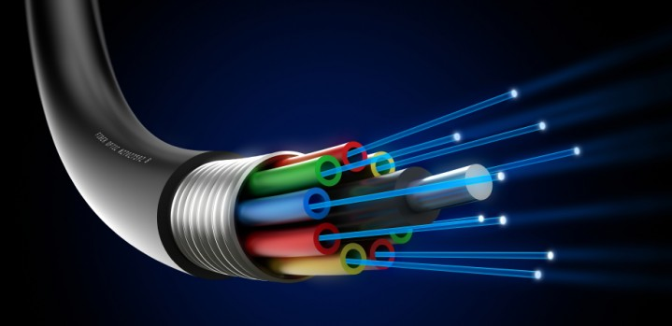
Guided media

Slide 7
Analogy to postal networks
Envelop (packet) contains message and destination address
You will drop the envelop at a local post office
The local post office will forward the envelop to a head post office (switch).
The head post office will find a route to the destination and forwards the envelop to next post office in the route.
It will reach a local post office closest to the destination
The envelop gets delivered by the local post office of the destination.

Slide 8
Protocol
A protocol is a set of rules between the communicating parties on how communication should start and proceed.
For example, you have been to a restaurant. We do not directly walk into the kitchen for food!
Typically, we follow a procedure to get the desired food:
Ask for the menu
Browse through the menu and decide the items
Call waiter and order your favourite dish
Wait for food to be prepared and get served
Once food is served, eat
Pay the bill (Do not forget !!!)

Slide 9
Protocols in Networks
Similar to protocols in our daily life, communication in computer networks happen under some protocols.
For example, there are some set of rules (protocol) to
establish a connection between two computers
forward the packets from one router to another router
modify the header of a packet at various layers in the network.
HyperText Transfer Protocol (HTTP), Transmission Control Protocol (TCP), Internet Protocol (IP) are some examples of protocols.

Slide 10
Who provides access to a network
Suppose, you have a computer to be connected to internet
You have connect to a switch that is connected to internet and forwards your data into the network.
It is the internet service provider (ISP) that connects your computer to his switch that is already connected to internet.
Examples of ISPs
BSNL, Airtel, Reliance, etc
IIIT Sri City
Lepakshi communications (Creekside, Sullurpeta)

Slide 11
Network edge

Slide 12
ACCess networks
The physical links that connect an end system to the first router on a path from the end system to any other end system.
Types of connections:
Dial-Up
Digital Subscriber Line (DSL)
Cable
Hybrid Fiber Coax (HFC)
Fiber-To-The-Home (FTTH)
Ethernet
Wireless Fidelity (WiFi)

Slide 13
Dial-up access network
Uses home land line cable
Software dials an ISP’s phone number and makes a connection with the ISP
Dial-Up modem:
Converts the digital output from PC to a suitable form for transmission over the telephone line
Converts the analog signal on the telephone line into digital form for input to the PC
Modem at ISP with similar functionalities
Low speed (56 kbps) and can not make phone calls when connected to internet

Slide 14
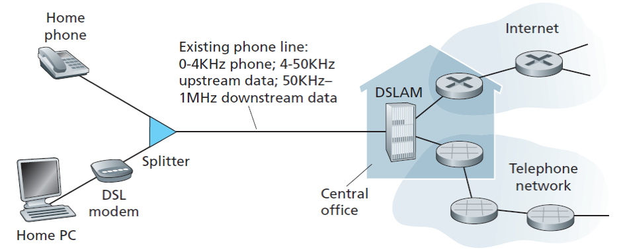
Digital subscriber line

Slide 15
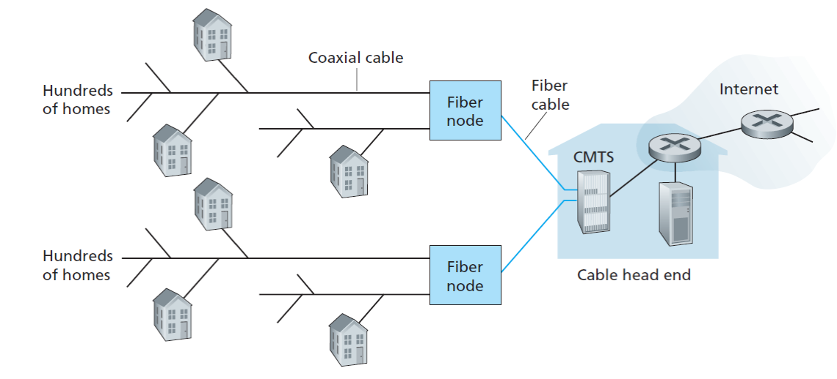
Cable and Hybrid fiber coax
Makes use of cable television infrastructure
Cable TV operator is an ISP

Slide 16
Network core

Slide 17
How are the end systems connected
Circuit switching
A dedicated path from source to destination
Resources on the path are reserved for the source-destination pair
Packet switching
No dedicated path from source to destination
A switch/router forwards packets to another router / destination on the path.

Slide 18
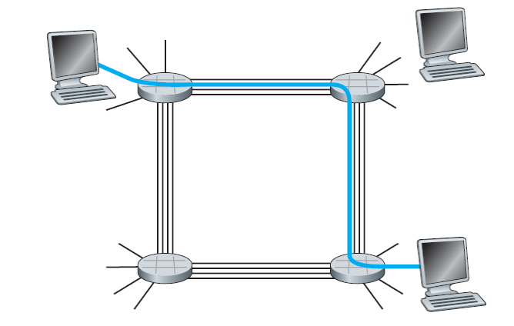
Circuit switching
The network establishes a connection from source to its destination. This connection is called circuit.
Resources such as bandwidth, buffers on the circuit are blocked for the duration of communication.
Telephone network is a circuit switching network.
Links are finite, so very few users can be supported simultaneously.

Slide 19
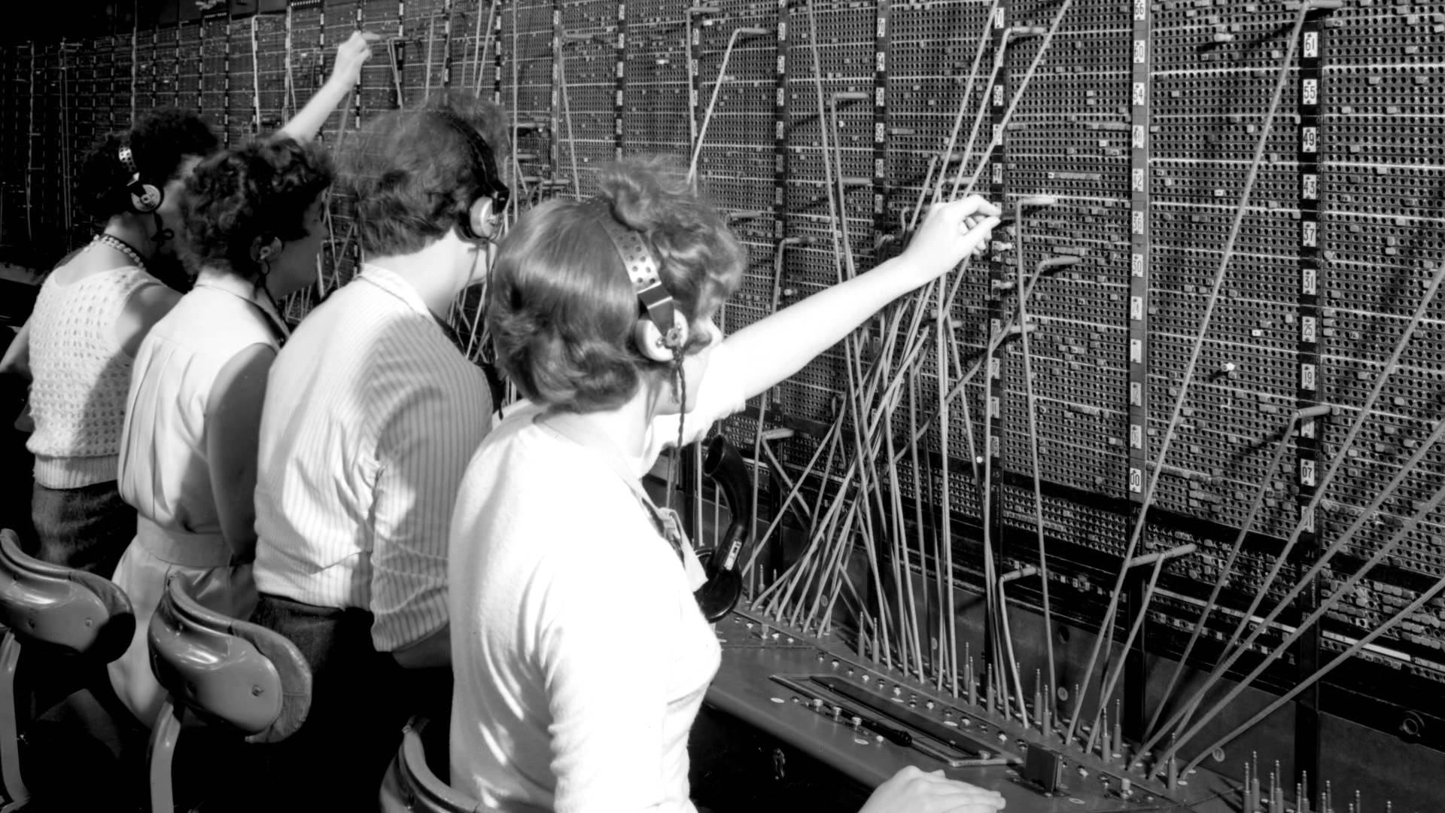
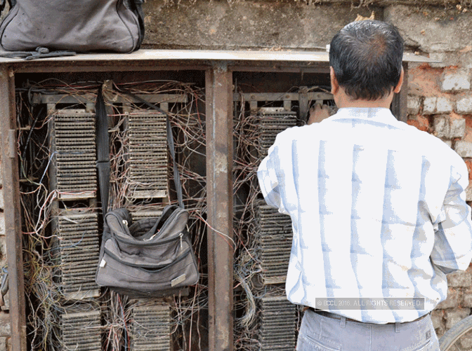
Circuit switching

Slide 20
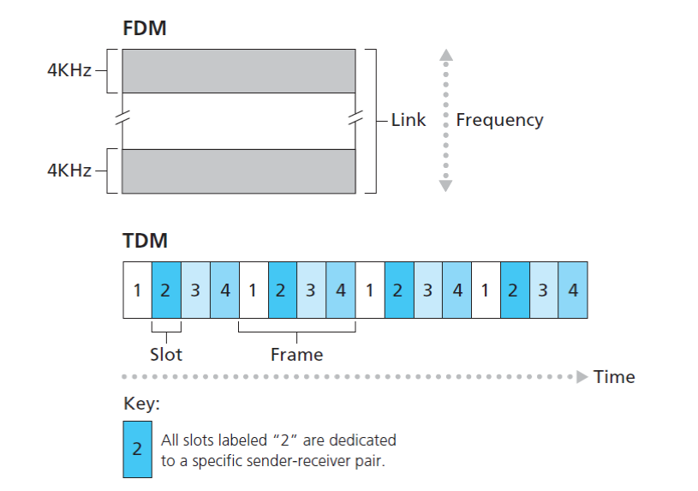
Multiplexing in circuit switching

Slide 21
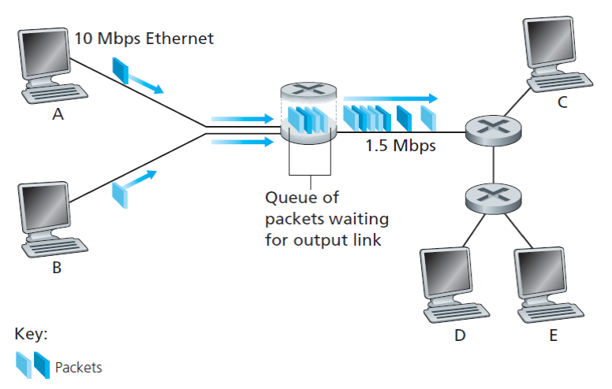
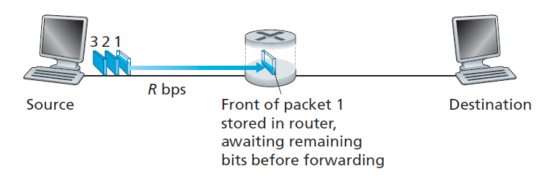
Packet switching

Slide 22
Statistical multiplexing
Suppose users share a 1Mbps link.
A user can be active or inactive. User will generate 100Kbps when active and we assume that a user is active for 10% of the time.
Circuit switching : 100Kbps must be reserved for each user all the time, can support 10 users simultaneously!
Circuit switching with TDM:
Say, one-second frame is divided into 10 frames each of 100ms.
Only 10 simultaneous connections are supported!!!

Slide 23
Statistical multiplexing
Packet switching: Let there be 35 users in the system. What is the probability that 11 or more users are active simultaneously?
Approximately 0.0004
As the probability of more than 10 users being active simultaneously is small, Packet switching can support 35 users!
Packet switching allocate links on demand
On demand allocation of resources is referred to as Statistical multiplexing.

Slide 24
Circuit switching vs Packet switching
Circuit switching
Packet switching
Waste of bandwidth in silent periods
Expensive
Supports less number of connections
Suitable for real-time services (video conferencing, etc)
Effective use of bandwidth
Cheaper than circuit switched network
Supports more simultaneous connections
Queuing delays
Packet loss
Not suitable for delay constrained applications

